Slide 1
Ecommerce Presentation
Presentation by Ultan Kearns & Ross Heany

Slide 2
Why an ecommerce site
Ecommerce is a rapidly growing industry
Ecommerce websites offer a variety of useful experiences to programming as there are many factors to consider EG. UI design, security, Server-side communication etc.
Designing an ecommerce site is a challenge which allows developers to grow and cultivate their skills
Ecommerce projects look good to possible employers as the typical business is migrating from brick & mortar to click & mortar rapidly
Many big businesses deal in online retail EG. Amazon, Ebay, Bookdepository, wish, Alibaba and many more

Slide 3
Why MEAN(Mongo,Express,Angular,Node) Stack
MEAN stacks offer a great start to any project as they speed up development of applications rapidly
MEAN stacks cover both front and backend development of websites
MEAN stacks are growing in popularity
MEAN stacks offer developers everything they need to build an application template in minutes.
Offer the latest and greatest in terms of functionality(SPA(Angular),Fast data access(mongo), server setup(Node) and server framework(Express))
Multiple companies use node(Netflix,NASA,Linkedin,Uber,PayPal just to name a few)

Slide 4
Mongo
Mongo is very fast at retrieval
Mongo allows us to store items simply and retrieve the items in a relatively short amount of time(depending on data size)
Mongo is ubiquitous in companies as according to https://idatalabs.com/tech/products/mongodb there are 26,929 companies that use mongodb as of reading this article.
Mongo scales easily
Mongo is schemaless(can hold different types of data objects)

Slide 5
Express
Easy to configure and customize for the developers needs
Allows you to create a REST API server
Easy to connect to databases with express to retrieve and submit information
Includes a lot of middleware modules to perform additional tasks
Allows developer to define routes through the application

Slide 6
Angular
Asynchronous JS which allows for fast retrieval of pages as the javascript is loaded asynchronously
Separates each component which makes it far easier to debug and maintain especially in group projects
Has a lot of support in IDEs
Allows for 2 way data binding
Very easy to build single page applications with angular
Ubiquitous throughout the IT industry

Slide 7
Node
Open source js runtime environment which allows for fast development of server side applications
Fast as it offers a lot of throughput
Node is scalable and you can upgrade it’s functionality easily
Node package manager offers many packages for use in your application which can reduce development time
Productivity increased as node is very fast to develop in and offers a variety of packages through the package manage

Slide 8
Project Aims & Goals
Allow user to login to application(Authentication but not full login)
Allow user to purchase items from site
Allow user to enter and change information stored on site
Allow user to create accounts(Completed)
Allow user to submit bugs with site(Completed)
Allow user to navigate site easily(Completed)
Make UI intuitive(Completed to best of abilities)
Allow user to navigate by category(Completed)
Gain a substantial knowledge of Full Stack development(Completed)

Slide 9
Project Layout
The project is broken up into 13 components these are:
About page: lists info about company
Account page: to change password for account
Books page: category page for book items
Cart: this contains items user purchased
Deals: contains pictures and links to items on sale
Electronics: category page
Forgot page: allows user to receive their account password on email if they have valid account

Slide 10
Project Layout Continued
Homepage: This is the home page shows pictures of items as well as toolbar and links under images
Login page: allows user to enter username and password to login
Outdoors: category page
Register: Allows user to register account
Sports: category page
Support: allows user to submit bugs with site to dev team
In addition to components we use services to push or retrieve information from server: cart service, authentication service, bugpost service, register service, retrieve service,product service

Slide 11
How we used project technologies
We used Mongo to define schemas for the items and Mlab to store the items in an online Database.
We used Node and Express to push and retrieve information to and from the server
We used Angular to code up the functions for pushing and retrieving information to and from the application to the server
We used HTML and SCSS to code up the HTML pages and style them.

Slide 12
What we learned
We learned how to work with the MEAN stack effectively and how to fully develop a full stack application
We learned about UI design and how to create a good user experience
We learned how to work in a team and fix merge errors which occurred in the project repository
We learned time-management skills
We learned how to manage projects and delegate work during the development of the project

Slide 13
Skills learned
We learned different terminology in angular
We learned how to develop a backend to retrieve and get information from a database
We improved our knowledge of Mongo and the MEAN stack in general
We learned how to break a github repository into branches for a professional development environment
We learned communication skills in the course of this module when discussing our progress with the supervisor

Slide 14
Difficulties we ran into
Time management was difficult as a lot of work goes into maintaining a good work ethic and developing complex functionality for an ecommerce site
Merge errors occurred a decent amount as it is almost impossible to avoid merge errors in a group project
Relearning angular and improving our knowledge of mongo and angular was difficult at the start as we had to remember and improve our knowledge of the technology

Slide 15
Overall Impression of Project
Overall developing this project was a good experience as it thought us more about the MEAN stack and how to utilize it in a professional style application
The project offered us many insights in what goes into an ecommerce sight and how to design the site from a user’s perspective
The project also showed us the full extent of the job responsibilities of a full stack developer
The project showed us what a typical working environment would be like

Slide 16
What I did – Ultan Kearns G00343745
Got routing working
Wrote retrieval service for all items to retrieve items from DB
Got authentication working – for login
Styled items pages and populated with items data based on category
Got authentication working
All support page both creation of bugs on DB and layout
Register page both layout and creation of users on DB
Got forgot page working both sending emails and layout
Styled application by adding margins to buttons and using angular mat-materials

Slide 17
What I did – Ultan contd.
Added models for bug and user to define the layout of bug and user objects
Wrote bugpost, retrieval and register services.
Added links + items to homepage also styled
Added links to deal page

Slide 18
What I did – Ross Heaney

Slide 19
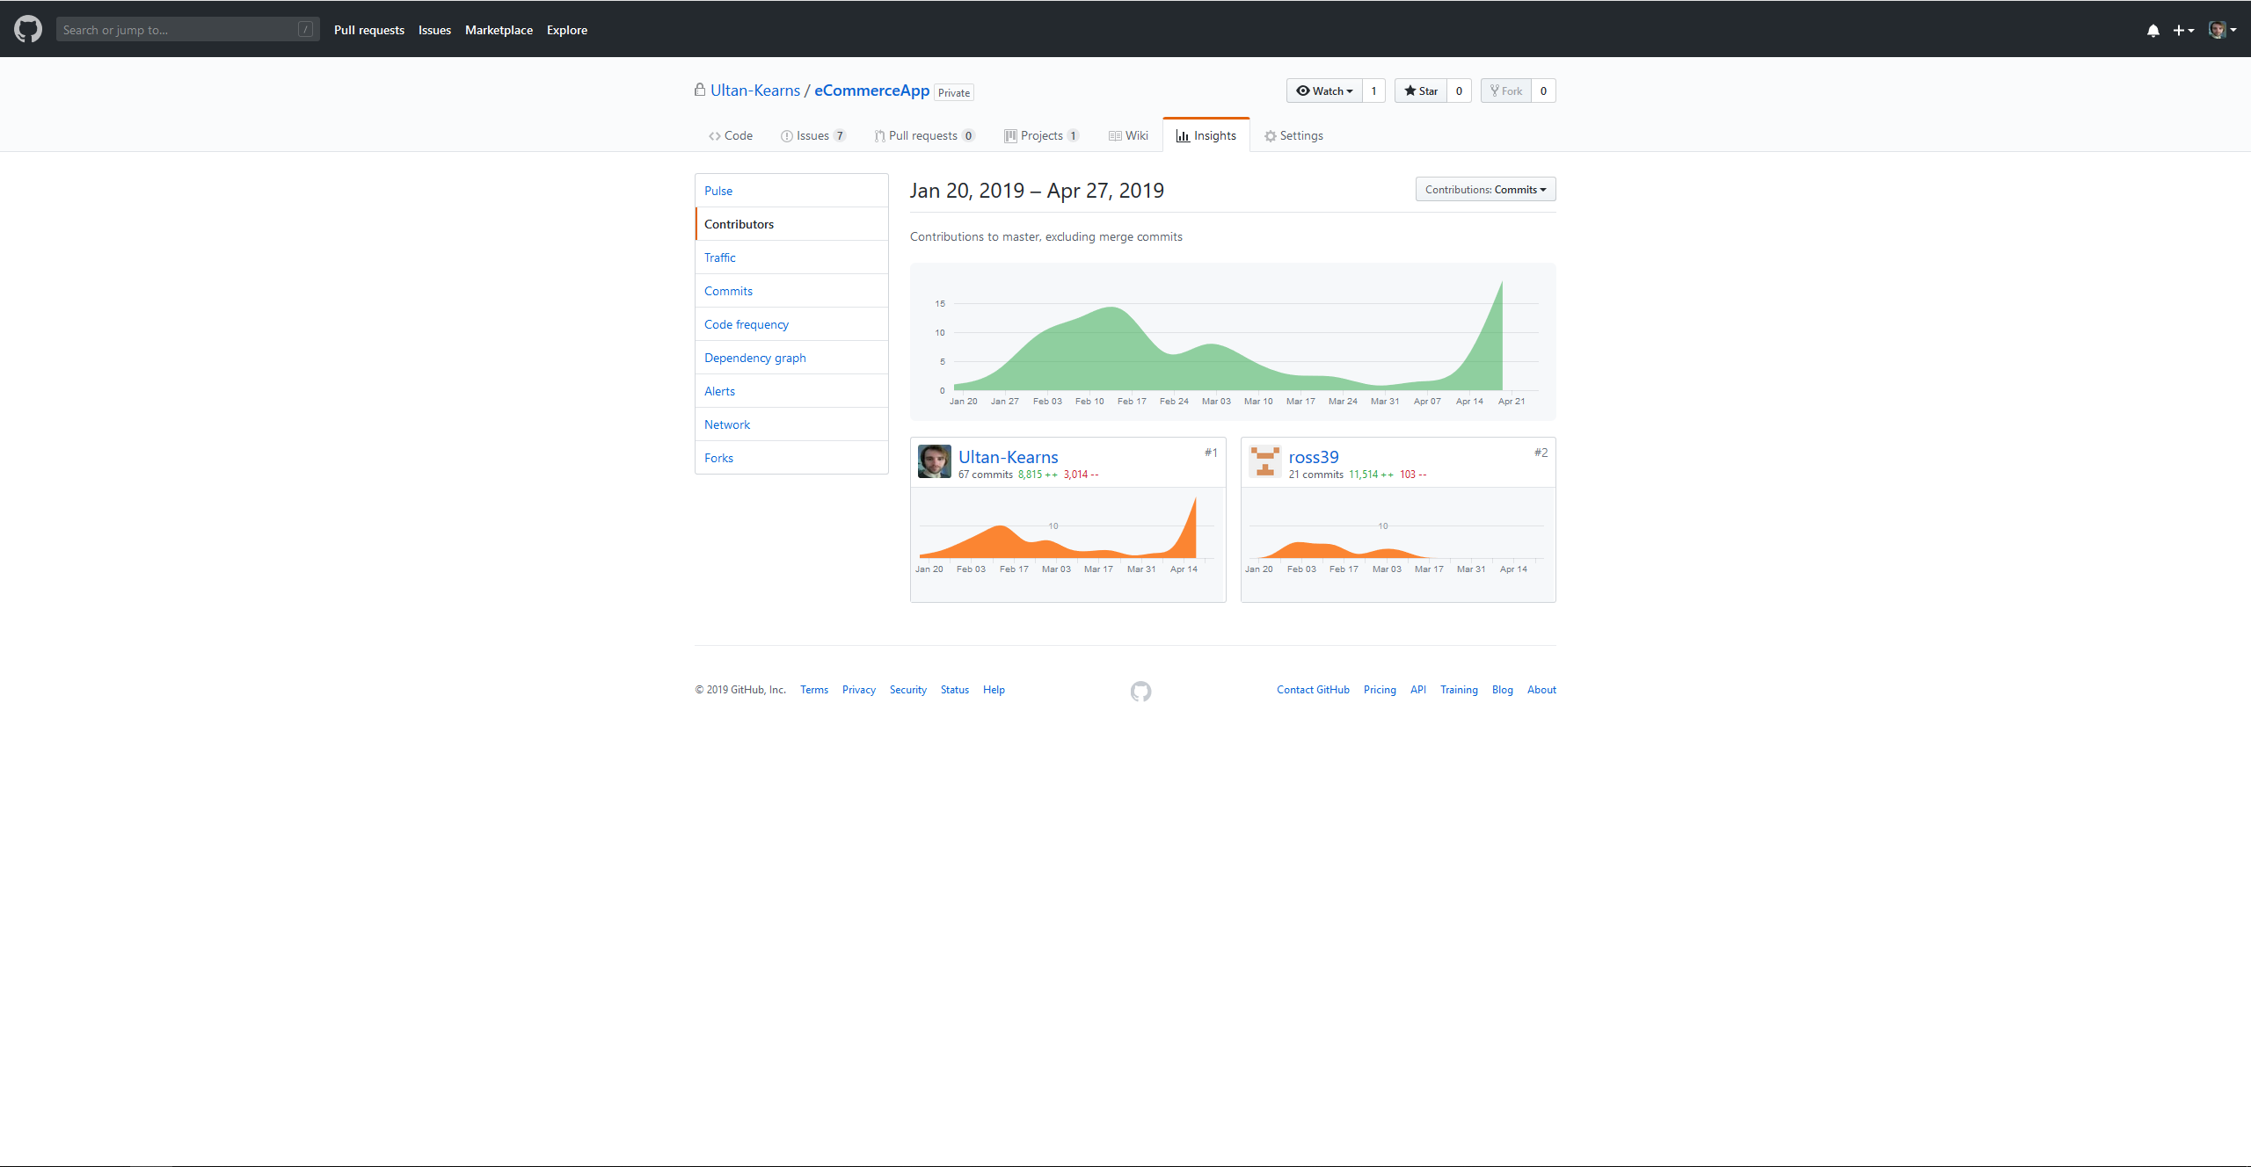
Github commits

